Slide 1
IFRS for SMEs The Future of UK GAAP?
Paul Webster
October 2009

Slide 2
Overview
Introduction to IFRS for SMEs
Current reporting requirements in the UK
ASB proposals for the future of UK GAAP
Potential impact of proposals

Slide 4
The Way Forward
IFRS (FULL)
IFRS
(Reduced)

Slide 5
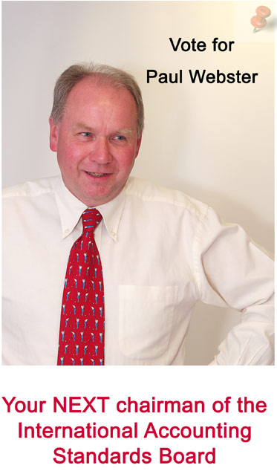

Slide 6
IASB Response
Not publicly accountable
Recognition and measurement
Stand alone
230 pages (10% IFRS)
Some topics omitted
Topics in sections
Fewer options
Simplified
Reduced disclosure
Suitable for SMEs?

Slide 8
Small and Medium-Sized Entities
Who are they?
Do not have public accountability
No debt or equity traded on public market
No assets held in a ‘fiduciary capacity’ as one of its primary businesses eg banks, insurance companies
Publish general purpose financial statement for external users
No size criteria

Slide 9
Concepts and Pervasive Principles
The objective of financial statements of SMEs and the qualities that make them useful:
Economic decision-making by a broad range of users
Results of the stewardship of management
Understandability, relevance, materiality,…
Hierarchy of accounting policies:
Per the IFRS for SMEs but if not addressed
Relevant and reliable
Similar transactions or issues
Concepts and pervasive principles from section 2

Slide 10
The Financial Statements
A statement of financial position
Either:
A single statement of comprehensive income, or
A separate income statement and statement of comprehensive income
A statement of changes in equity
A statement of cash flows
Notes
Consolidated financial statements may be required

Slide 11
The gOOd
Accounting Treatments – The Easy Bits
Tangible fixed assets – no revaluations allowed
Intangibles – amortise over useful life or 10 years, impair if necessary
Stocks, normal trade debtors and creditors, cash, prepayments and accruals
Revenue recognition and expense recognition
Share capital
Leasing

Slide 12
The gOOd
Accounting Treatments – The Easy Bits
Development costs – expensed
Borrowing costs – expensed
Associates, joint ventures – cost, fair value or equity method
Impairments – same principles but less prescriptive
Government grants – income subject to conditions
Related parties – no names but requirement to disclose total remuneration to key management

Slide 13
The bad
Accounting Treatments - Borderline
Share-based payments – P&L charge required but can use estimates
Business combinations – no merger accounting unless under common control, need to identify intangible assets purchased
Post-employment benefit plans – measure obligation but without using external specialists
Deferred tax based on temporary differences

Slide 14
And The ugly
Accounting Treatments – Financial Instruments
‘Basic’ financial instruments are held at amortised cost and written down if there is objective evidence of impairment
Eg trade debtors, creditors, bank loans, etc.
Investments are measured at fair value through profit or loss if they can be measured reliably, otherwise amortised cost
‘Complex’ financial instruments are held at fair value through the profit or loss
Limited hedging provisions

Slide 15
ASB Consultation – Future of UK GAAP
AIM
Simplify reporting by having more proportionate reporting requirements based on accountability and size;
Reducing burden by basing UK GAAP on IFRS;
Improve comparability and understandability of financial reports

Slide 16
ASB Consultation – Future of UK GAAP
Tier 1
PUBLICLY ACCOUNTABLE
EU IFRS
Tier 2
THE ‘MIDDLE TIER’
IFRS FOR SMEs
Tier 3
SMALL COMPANIES
FRSSE
Tier 4
MICROS
Simple accounts following basic rules?

Slide 17
The Way Forward
For listed companies/ banks/ insurance companies
IFRS (FULL)
With exemptions for small companies
IFRS
(Reduced)

Slide 18
The Way Forward
Small companies should use IFRS for SMEs but excluding the following:-
Statement of cash flows
Consolidated financial statements
Financial instruments
Post employment benefits – define pension plans
Deferred tax

Slide 19
Conclusion
A significantly better document than the previous standard
Abolish UK GAAP
Do not adopt the accounting rules for ‘MICROS’
Replace FRSSE with exemptions for small companies from IFRS for SMEs

