Slide 1
Ozge Ogreten, CPA Auditor
DOING BUSINESS IN TURKEY
ULUSAL AUDITING AND CPA CO.
October 2009

Slide 2
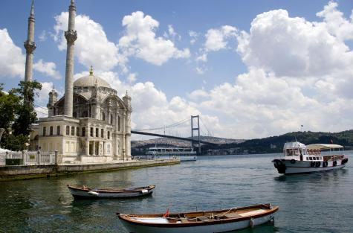
CONTENTS
INVESTING IN TURKEY
FORMING A COMPANY
TAXATION
ACCOUNTANCY AND AUDITING
LABOR
APPENDIX – USEFUL LINKS

Slide 3
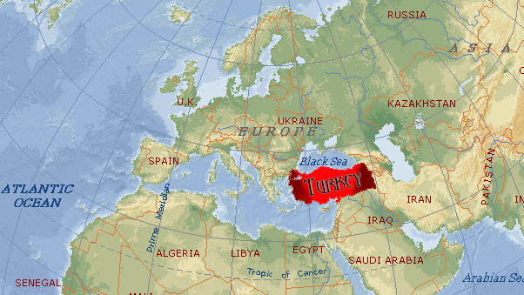
KEY ATTRACTIONS OF TURKEY
STRATEGICALLY SITUATED -
Turkey is a country offering
significant opportunities for
foreign investors with its
geographically perfect position
to function as a gateway between
Europe, Middle East and
Central Asia.

Slide 4
KEY ATTRACTIONS OF TURKEY
CUSTOMS UNION WITH EU COUNTRIES
SUPPLY OF HIGH QUALITY AND COST-EFFECTIVE LABOR FORCE

Slide 5
KEY ATTRACTIONS OF TURKEY
FLEXIBLE EXCHANGE RATE AND LIBERAL IMPORT REGULATIONS
DOUBLE TAXATION AGREEMENTS AND TAX INCENTIVES

Slide 6
KEY ATTRACTIONS OF TURKEY
LARGE AND GROWING DOMESTIC MARKET
MATURE AND DYNAMIC PRIVATE SECTOR

Slide 7
KEY ATTRACTIONS OF TURKEY
DEVELOPED INFRASTRUCTURE
INSTITUTIONALIZED ECONOMY

Slide 8
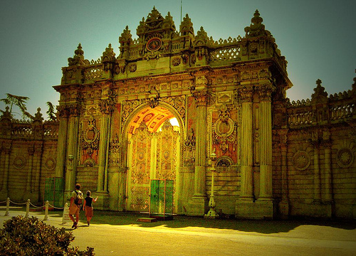
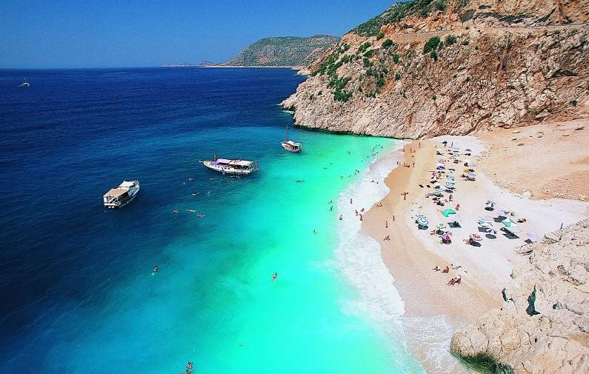
KEY ATTRACTIONS OF TURKEY
WITH ITS WONDERFUL CLIMATE, CHARMING TOWNS AND VILLAGES, GOLDEN BEACHES, WEALTH OF HISTORY AND FRIENDLY, HOSPITABLE PEOPLE…

Slide 9
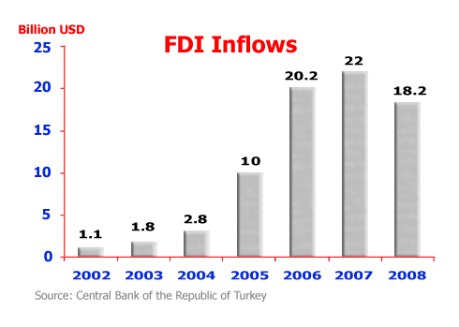
FDI IN TURKEY
Turkey is the 15th most attractive destination for foreign direct investment (FDI) in the world (UNCTAD World Investment Prospects Survey, 2008-2010).

Slide 10
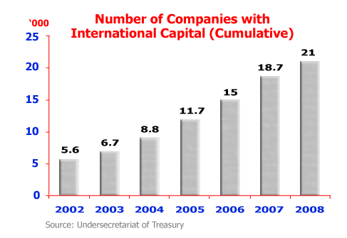
FDI IN TURKEY
Currently, a total of 21,079 companies with international capital are operating in Turkey. Among these, 17,160 companies and branch offices with international capital have been established, while 3,919 existing domestic companies received foreign capital.

Slide 11
FORMING A COMPANY
The Turkish Commercial Code provides several company structures in Turkey:
joint stock companies,
limited liability companies,
collective companies,
partnerships limited by shares and co-operative associations.
The legal difference between those company structures mainly concern the allocation of liability and the legal form of the entity.

Slide 12
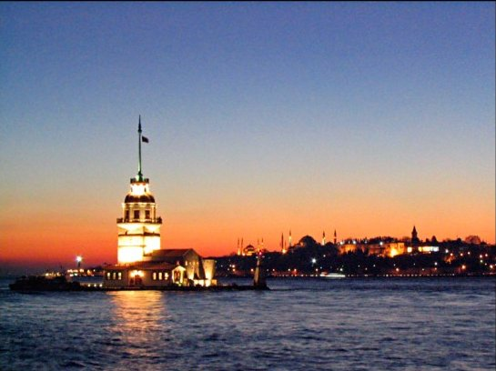
FORMING A COMPANY
The two most popular forms of business entity in Turkey are:
LIMITED LIABILITY COMPANIES (LTD. STI.)
JOINT STOCK COMPANIES (A.S.)

Slide 13
FORMING A COMPANY
LIMITED LIABILITY COMPANIES (LTD. STI.)
Minimum of two shareholders.
Shareholders may be Turkish or foreign nationals.
The minimum capital is TL 5.000 (of which 25% should be paid up.)

Slide 14
FORMING A COMPANY
JOINT STOCK COMPANIES (A.S.)
Minimum of five shareholders (no nationality requirement)
Board of Directors (minimum three directors).
The minimum capital is TL 50.000 (of which 25% should be paid up.)
All A.S. companies are required to have their accounts audited.
Companies in Turkey that are owned by foreign investors are usually A.S. companies.

Slide 15
FORMING A COMPANY
HOW EASY IS IT TO OPEN A TURKISH COMPANY?
Few countries do it faster.
You can open a Turkish company
inside a day, provided you have
the correct documentation to hand.

Slide 16
FORMING A COMPANY
Since 2003 foreign investment has been regulated in a more liberalized manner under Foreign Direct Investment Law, No. 4875. Under this law foreign investors may freely start up business in company, branch office or liaison office forms.

Slide 17
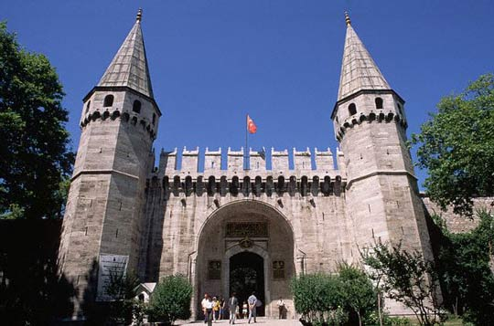
TAXATION
The tax system in Turkey is progressive. In other words, the higher your income, the higher the rate at which you will pay tax.
The standard rate of Turkey corporate tax is 20%.
The individual tax rates vary from 15% - 35%.

Slide 18
TAX ENVIRONMENT : SPECIFICITIES
TAX RESIDENCY
According to Turkish tax legislation, income taxation differs significantly based on where the taxpayer is resident.
If both the legal and the business headquarters of a company are located outside Turkey, the company regarded as a non-resident entity.
If one of these headquarters is located within Turkey, the company regarded as a resident entity.
Resident entities are subject to tax on their worldwide income, whereas non-resident entities are taxed solely on the income from activities in Turkey.

Slide 19
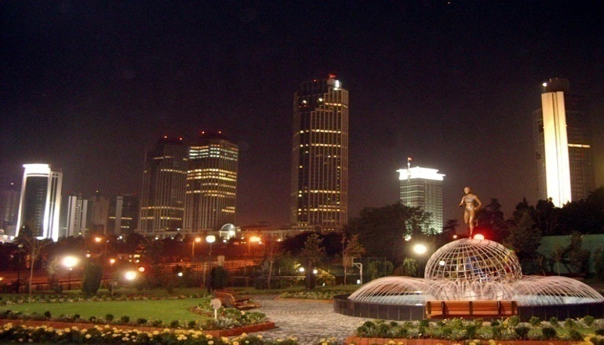
TAX ENVIRONMENT : SPECIFICITIES
TAXABLE INCOME
Income of Turkish corporations is always treated as income from a business enterprise. Taxable income from such an enterprise is defined as the difference between the net worth at the end of the year and the net worth at the end of the preceding year, with certain adjustments, mainly to eliminate capital items and to recognize special statutory allowances and disallowances.

Slide 20
TAX ENVIRONMENT : SPECIFICITIES
CORPORATION TAX SYSTEM
Corporations are liable to taxation as described below:
Profits generated, as adjusted for exemptions and deductions, including prior-year losses carried forward, are liable corporation tax at 20 %.
Dividend distributions to individual and non-resident corporate shareholders are subject to withholding tax at the rate of 15 %. This rate might be reduced in the existence of tax treaty.

Slide 21
TAX ENVIRONMENT : SPECIFICITIES
CORPORATION TAX SYSTEM
Corporations are required to pay advanced corporation tax based on their quarterly balance sheets and income statements at the rate of 20 %. Advanced corporation tax paid during the year is offset against the corporate tax liability calculated over the annual corporate tax return. The balance of advance tax can be refunded or used to offset other tax liabilities.

Slide 22
TAX ENVIRONMENT : SPECIFICITIES
CORPORATION TAX SYSTEM
Turkish Corporate Income Tax Legislation allows as a deduction of “all the ordinary and necessary expenses paid or incurred during the taxable year in carrying on any trade or business”.
Corporate losses may be carried forward for five years, but losses may not be carried back.

Slide 23
TAX ENVIRONMENT : SPECIFICITIES
RELATED PARTY TRANSACTIONS
In principle, transactions between the related parties must be carried out on an arm’s length basis.
Transfer pricing – With the new Corporate Income Tax Law, considerable amendments are made to transfer pricing regulations, taking OECD transfer pricing guide as a basis.
Thin capital rules - The Corporate Tax Law imposes a specific debt/equity ratio of 3:1 for consideration of thin capital.

Slide 24
TAX ENVIRONMENT : SPECIFICITIES
RELATED PARTY TRANSACTIONS
Thin capital - Interest, foreign exchange losses and other similar expenses related to the loans regarded as thin capital are treated as non-deductible expenses for the corporate income tax purposes.
Controlled Foreign Corporation (CFC) - The profits of CFC controlled by tax resident companies or persons are subject to corporate income tax in Turkey irrespective whether profits distributed or not with the fulfillment of some conditions, i.e. 25 % or more of the gross revenue must be composed of passive income, the CFC must be subject to an effective income tax rate lower than 10 % in its home country, etc.

Slide 25
TAX ENVIRONMENT : SPECIFICITIES
INCOME TAX ON INDIVIDUALS
An individual in Turkey is liable for tax on his income as an employee and on income as a self-employed person. Income tax rates applicable as from 2009 are as follows:
INCOME SCALES (TL) | RATE (%)
Up to 8,700 | 15
8,701-22,000 | 20
22,001-50,000 | 27
50,001 and upwards | 35

Slide 26
TAX ENVIRONMENT : SPECIFICITIES
MAJOR TRANSACTION TAXES
VALUE ADDED TAX– Deliveries of goods and services are subject to VAT at rates varying from 1% to 18 %. The general rate applied is 18 %.
WITHHOLDING TAX – Income tax on salaries of employees, lease payments to individual landlords, independent professional service fee payments to resident individuals; and royalty, license and service fee payments to non-residents. Withholding tax rates vary from 1% to 35% and may be reduced based on the available bilateral tax treaty provisions.

Slide 27
TAX ENVIRONMENT : SPECIFICITIES
TAX INCENTIVES IN TURKEY
Exclusion Of Investment Deduction
Deduction Of Research & Development
Gain exclusion on education and instruction businesses
Incentive of value added tax in vehicles, oil searching and incentive certificated investments
Tax incentives in industrial zones, technology developing zones, free zones, emergency zone and priority development areas, organized industrial zones.

Slide 28
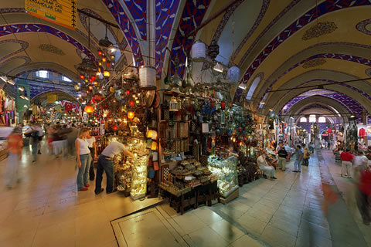
TAX ENVIRONMENT : SPECIFICITIES
TAX INCENTIVES IN TURKEY
Tax and fees exclusion in providing credits
Tax Incentives for rising of investment and employment
Tax incentives for cultural investments and enterprises

Slide 29
ACCOUNTANCY AND AUDITING
CORPORATE FINANCIAL REPORTING REQUIREMENTS
Financial Statements Entities | Legal Entity Financial Statements | Consolidated Financial Statements
Joint Stock and Limited Liability Companies
Large and medium | Tax Procedural Law and UCA | No requirement
Small entities and sole proprietors | Basic Concepts of Accounting set out in the ASIR | No requirement
Publicly-held companies | Tax Procedural Law, UCA and Communiqués issued by the CMB (Required to follow IFRSs) | Communiqués issued by the CMB (Required to follow IFRSs)
Banks | Specific accounting requirements within the Regulations and Communiqués issued by the Banking Regulatory and Supervisory Agency (BSRA), as established by the Banks Act (Required to follow IFRSs)
Insurance companies | Specific accounting requirements within the Regulations and Communiqués issued by the GDI | No requirement

Slide 30
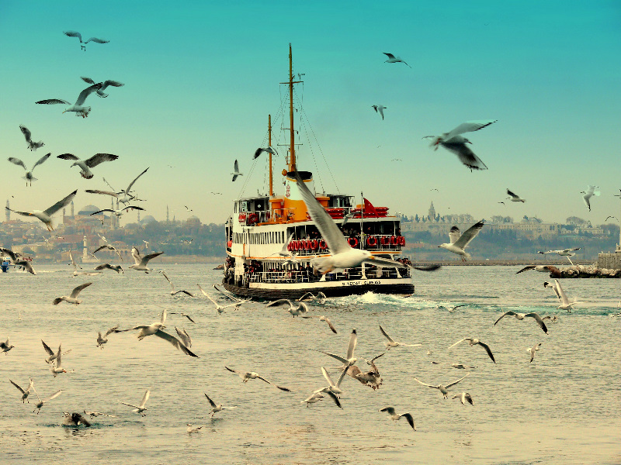
ACCOUNTANCY AND AUDITING
AUDIT EXEMPTION
A company can be an audit exempt company if it meets the following criteria:
its annual turnover is 4,264,000 TL or less;
its balance sheet total is 8,528,000 TL or less;

Slide 31
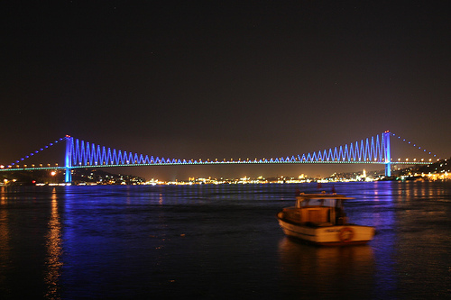
ACCOUNTANCY AND AUDITING
NEW COMMERCIAL CODE
A new commercial code is currently with the General Assembly of the Parliament for approval, The Code aims to integrate the Turkish Commercial Code with EU law, improve transparency, protect minority rights and strengthen corporate governance principles.

Slide 32
ACCOUNTANCY AND AUDITING
NEW COMMERCIAL CODE
A new commercial code is currently with the General Assembly of the Parliament for approval. Aims of the new CC
Integrates CC with EU law
Fair competition
Infrastructure for transparency and information society
Corporate Governance principles
Generally accepted accounting and audit standards
Democracy among shareholders
Use of information technology tools

Slide 33
ACCOUNTANCY AND AUDITING
NEW COMMERCIAL CODE
More Transparency | Turkish Accounting Standards identical to IFRS and announcement of the audited accounts through websites Annual reports Independent audit Comprehensive disclosure of transactions with group companies Corporate Governance report to be published by public companies Internet site
Fairness | Electronic voting on General Board and Board of Directors Corporate representation Protection of rights of minority shareholders
Accountability and Responsibility | Professionalism and specialization in bodies emphasized Finance management, internal audit, financial planning and risk management

Slide 34
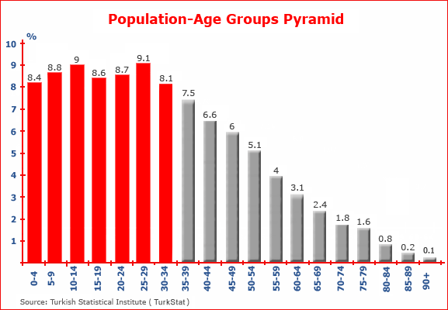
LABOR
POPULATION
Turkey has a total population of 72 million with an average age
of 28.5.

Slide 35
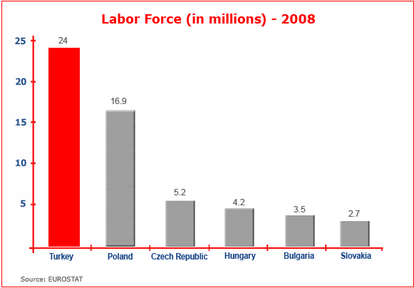
LABOR
LABOR FORCE
Turkey has a total population of 72 million, of which 24 million people are active in the labor force, and Turkey is the 5th largest labor force compared with the 27 EU countries.

Slide 36
LABOR
WORKING TIME
In general the working week consists of maximum 45 hours. Total working hours may be divided freely to the number of working days; however, working hours cannot exceed 11 hours in any day.
The overtime work is defined as the working hours, which exceeds 45 hours in a week. The days on which overtime work is done cannot exceed 270 hours a year.

Slide 37
LABOR
LABOR COSTS
Wage regulation - There is no ceiling to the wages that can be given. On the other hand, wages cannot be below the minimum wage.
Bonuses and Other Extra Payments - There are no legal obligations in this respect.
Social security premiums are compulsory in respect of all persons earning salaries and wages.

Slide 38
LABOR
LABOR COSTS – SOCIAL INSURANCE PREMIUMS
Social insurance premiums are calculated on the basis of the monthly wages and are paid jointly by the worker and the employer at the following rates:
BRANCHES | EMPLOYEE % | EMPLOYER % | TOTAL %
Occupational accidents and diseases (varies according to the job) Illness Maternity Disability, Old Age, Death | - 5 - 9 | 1.5-7 6 1 11 | 1.5-7 11 1 20
Total Minimum | 14 | 19.5 | 33.5
Total Maximum | 14 | 25 | 39
Unemployment Insurance | 1 | 2 | 3

Slide 39
APPENDIX – USEFUL LINKS
USEFUL LINKS
Organization | Website
Under secretariat of Foreign Trade | www.foreingtrade.gov.tr
Central Bank of Turkey | www.tcmb.gov.tr
Under secretariat of Treasury | www.treasury.gov.tr
Ministry of Finance | www.maliye.gov.tr
Turkish Revenue Administration | www.gib.gov.tr
Ministry of Foreign Affairs | www.mfa.gov.tr
Ministry of Industry and Commerce | www.sanayi.gov.tr
Ministry of Labor and Social Security | www.calisma.gov.tr
Customs Administration | www.gumruk.gov.tr
Association of Foreign Investors | www.yased.org.tr
Union of Chambers of CPAs of Turkey | www.turmob.org.tr
Investment Support and Promotion Agency | www.invest.gov.tr

Slide 40
CONTACT DETAILS
Ozge Ogreten
oogreten@ubdt.com.tr
Cuneyt Morgul
cmorgul@ubdt.com.tr
U. Taylan Aydemir
uaydemir@ubdt.com.tr
ULUSAL AUDITING AND CPA CO.
A Member of TIAG®, A Worldwide Network of Independent Accounting Firms
Registered Firm of US PCAOB “Public Company Accounting Oversight Board”
Inonu Cad. No: 113 34217 Mahmutbey
Bagcilar ISTANBUL – TURKEY
Phone: +90 212 446 40 00 (pbx)
Fax: +90 212 446 36 00
www.ubdt.com.tr

