Slide 1

Strategic Planning and Implementation
Using the Balanced Scorecard
October 27, 2009
John W. Sterling
Partner
Smock Sterling Strategic Management Consultants
Lake Bluff, IL
(847) 457-6122
jsterling@smocksterling.com

Slide 2
STRATEGIC PLANNING AND IMPLEMENTATION
USING THE BALANCED SCORECARD
Post-recession balancing act – clients/profits
The balanced scorecard – a tool designed for this issue
  What it is and how it works
  Looking at the four dimensions
Pragmatic steps to using the tool in a professional service firm
Case studies (time permitting)
Q&A

Slide 3
STRATEGIC PLANNING AND IMPLEMENTATION
USING THE BALANCED SCORECARD
THE BALANCING ACT

Slide 4
STRATEGIC PLANNING AND IMPLEMENTATION
USING THE BALANCED SCORECARD
The Post-Recession Balancing Act

Slide 5
STRATEGIC PLANNING AND IMPLEMENTATION
USING THE BALANCED SCORECARD
The Post-Recession Balancing Act (Cont’d)
The recession has had an impact on clients’ expectations of value (i.e., results ÷ costs)
  Persistent rate increases drove profit growth
  Entry level starting pay – highly visible and seemingly irrational
  Quality mid-size firms are proving to be capable…
Meanwhile, partner mobility has increased for a decade – following the recession it is fair to expect that mobility will return (particularly for those with strong client relationships)
  Financial performance matters in the battle for talent
  Thus, profit growth must return – and it is less and less likely to come simply from rate increases

Slide 6
STRATEGIC PLANNING AND IMPLEMENTATION
USING THE BALANCED SCORECARD
The Post-Recession Balancing Act (Cont’d)
Strategic planning and implementation need to balance the needs and expectations of these two key stakeholders
  Clients
  Shareholders/partners
The balanced scorecard was developed specifically with this need in mind

Slide 7
STRATEGIC PLANNING AND IMPLEMENTATION
USING THE BALANCED SCORECARD
BALANCED SCORECARD –
AN INTRODUCTION

Slide 8
STRATEGIC PLANNING AND IMPLEMENTATION
USING THE BALANCED SCORECARD
The Balanced Scorecard – An Overview

Slide 9
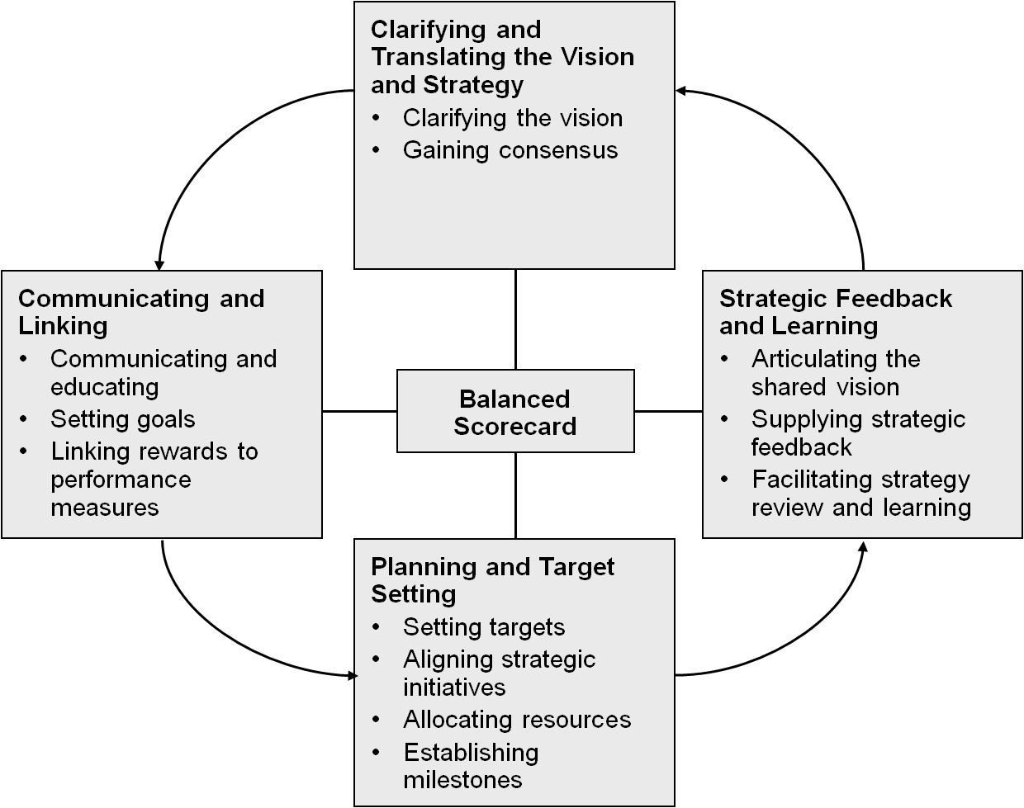
STRATEGIC PLANNING AND IMPLEMENTATION
USING THE BALANCED SCORECARD
The Balanced Scorecard – An Overview (Cont’d)

Slide 10
STRATEGIC PLANNING AND IMPLEMENTATION
USING THE BALANCED SCORECARD
The Balanced Scorecard – Financial Dimensions
The importance of (obsession with) PPEP grew steadily over the past decade
PPEP is a legitimate measure of financial performance – and it has become the de facto yardstick
Remember – there is a numerator and a denominator…

Slide 11
STRATEGIC PLANNING AND IMPLEMENTATION
USING THE BALANCED SCORECARD
The Balanced Scorecard – Financial Dimensions (Cont’d)
The numerator has many levers

Slide 12
STRATEGIC PLANNING AND IMPLEMENTATION
USING THE BALANCED SCORECARD
The Balanced Scorecard – Financial Dimensions (Cont’d)
The denominator has one lever – the number of equity partners
The euphemism for managing the denominator – “financial engineering” – is just another way of saying de-equitization and/or firing partners
It is reasonable to expect the business model to change in the coming years – and to expect equity ranks to continue to tighten
But, the balanced scorecard (and strategy development more broadly) is not about managing the denominator

Slide 13
STRATEGIC PLANNING AND IMPLEMENTATION
USING THE BALANCED SCORECARD
The Balanced Scorecard – Client Dimension
What do we (want to) look like to our clients?
How do we know when we have achieved that?
  Client diversification (breadth and diversity of client relationships)
    Number of clients at defined threshold
    No clients representing defined percentage of fees
  Large/Institutional relationship
    % of fees from large transactions/cases
    % of fees from clients over threshold level
    Increase in number of large relationships
  Depth and breadth of relationships
  Client satisfaction scores/feedback
  Third party rankings

Slide 14
STRATEGIC PLANNING AND IMPLEMENTATION
USING THE BALANCED SCORECARD
The Balanced Scorecard – Client Dimension (Cont’d)
Source: Redwood Analytics

Slide 15
STRATEGIC PLANNING AND IMPLEMENTATION
USING THE BALANCED SCORECARD
The Balanced Scorecard – Client Dimension (Cont’d)
Source: Redwood Analytics

Slide 16
STRATEGIC PLANNING AND IMPLEMENTATION
USING THE BALANCED SCORECARD
The Balanced Scorecard – Client Dimension (Cont’d)
Source: Stanford Research Institute

Slide 17
STRATEGIC PLANNING AND IMPLEMENTATION
USING THE BALANCED SCORECARD
The Balanced Scorecard – Business Process Dimension
Focus should be on processes that have a genuine impact on financial performance, on client satisfaction/experiences, or – ideally – on both fronts
Remember the demise of TQM and “Clients First” programs
Most meaningful business processes occur in one of two places in a law firm
  In practice groups – the closer to the delivery of services, the more meaningful the process
  In administrative functions – accounting, procurement, technology management, etc.
Time capture, billing and collection cycles are often low hanging fruit and link directly to realization

Slide 18
STRATEGIC PLANNING AND IMPLEMENTATION
USING THE BALANCED SCORECARD
The Balanced Scorecard – Business Process Dimension (Cont’d)
A brief word about alternative fee approaches
Understand your costs
Understand the clients’ motivations
  Saving money
  Predictability
  Shared risk
Business process is integral to aligning the two (costs and client motivations) – the solution is a by-product of that analysis

Slide 19
STRATEGIC PLANNING AND IMPLEMENTATION
USING THE BALANCED SCORECARD
The Balanced Scorecard – People and Capabilities
Learning and growth is about people, capabilities and tools that support them
People measures are often (too often) soft
Some hard (and hard to achieve) measures
  Associate recruiting and retention statistics/targets
  Diversity statistics and targets (relative to competition)
  Equity partner performance and standards
  External recognition
Organizational capability analyses – gap analysis can focus and prioritize resources and initiatives

Slide 20
STRATEGIC PLANNING AND IMPLEMENTATION
USING THE BALANCED SCORECARD
The Balanced Scorecard – People and Capabilities (Cont’d)
Current State OCA
Desired End State

Slide 21
STRATEGIC PLANNING AND IMPLEMENTATION
USING THE BALANCED SCORECARD
APPLYING THE CONCEPT –
A PRAGMATIC APPROACH

Slide 22
STRATEGIC PLANNING AND IMPLEMENTATION
USING THE BALANCED SCORECARD
Pragmatic Approach for Firms
First, get a strategic plan, then…
Firm level planning involves some basic steps
  Analytical rigor – internal and external environment
  Vision and direction setting
  Strategic positioning – where we intend to win
  Strategy development – high level resource allocation
  Implementation – plugging in the balanced scorecard
Articulate high level objectives or targets for profitability and client relationships
Express it simply – get it on one page

Slide 23
STRATEGIC PLANNING AND IMPLEMENTATION
USING THE BALANCED SCORECARD
Pragmatic Approach for Firms – One Page Plan

Slide 24
STRATEGIC PLANNING AND IMPLEMENTATION
USING THE BALANCED SCORECARD
Pragmatic Approach for Firms – Engage the Practices
Ultimately, implementation must involve the practice groups
Balanced scorecard tools were developed with business units (shared customers, shared products, shared processes) in mind
Engage the practices by “mapping” the firm’s strategy to each practice group – this can be top down or bottom up
Customize practice portfolio management tools to make it transparent and easy to use

Slide 25
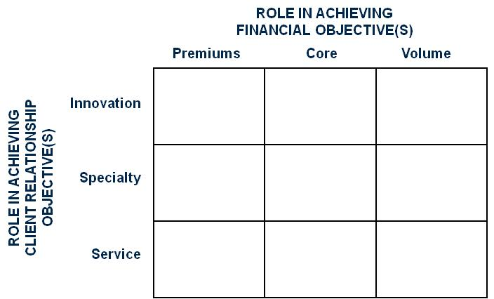
STRATEGIC PLANNING AND IMPLEMENTATION
USING THE BALANCED SCORECARD
Pragmatic Approach for Firms – Engage the Practices (Cont’d)

Slide 26
STRATEGIC PLANNING AND IMPLEMENTATION
USING THE BALANCED SCORECARD
Pragmatic Approach for Firms – Engage the Practices (Cont’d)
The practices then drive implementation via the use of balanced scorecard tools
  Direct actions related to financial performance
  Direct actions related to client and business development (external and cross-marketing)
  Direct action related to people/professional development
  Process improvement focus/initiatives
Set near term targets in each area
Denote champions or owners for each initiative
Meet, monitor and discuss the results

Slide 27
STRATEGIC PLANNING AND IMPLEMENTATION
USING THE BALANCED SCORECARD
Pragmatic Approach for Firms – A Continuing Cycle
Regular dialog and discussion – consultation to the practices and assistance from administration
Adjustment based on outcomes – of firm strategies and underlying assumptions
Annual planning at the practice level – in line with budgeting

Slide 28
STRATEGIC PLANNING AND IMPLEMENTATION
USING THE BALANCED SCORECARD
Pragmatic Approach for Firms – A Continuing Cycle (Cont’d)

Slide 29
STRATEGIC PLANNING AND IMPLEMENTATION
USING THE BALANCED SCORECARD
CASE STUDIES

Slide 30
STRATEGIC PLANNING AND IMPLEMENTATION
USING THE BALANCED SCORECARD
Case Studies
Mallesons Stephen Jaques – Australia and Pacific Rim
  Return to #1 ranking in client satisfaction
  Objective drivers of client satisfaction identified
  Getting a lawyer on the phone on the first call
  Development of PeopleFinder tool
  Results – 10,000 fewer VM, 1 million hits on PeopleFinder, #1 on BRW Client Choice Awards

Slide 31
STRATEGIC PLANNING AND IMPLEMENTATION
USING THE BALANCED SCORECARD
Case Studies (Cont’d)
Bryan Cave – US Based, global law firm
  Balance of financial and client at center of strategy
  Desktop tool development – right people on the matters
  Cost control, margin management, high satisfaction
  Results – 70% tool usage (including newly integrated PoGo lawyers); gains on every objective target

Slide 32
STRATEGIC PLANNING AND IMPLEMENTATION
USING THE BALANCED SCORECARD
QUESTIONS

