Slide 1

About TAGLaw
A Worldwide Alliance of Independent Law Firms

Slide 2
About TAG Alliances®
TAGLaw® and its sister alliances, TIAG ® and TAG-SP ®, combine to form TAG Alliances: an international, multi-disciplinary alliance of independent member firms.
  TAGLaw: Global alliance of 160+ independent law firms
  TIAG: Global alliance of 115+ independent accounting firms
  TAG-SP: Global multidisciplinary alliance of independent members (“Strategic Partners” such as trust companies, niche firms, etc.)

Slide 3



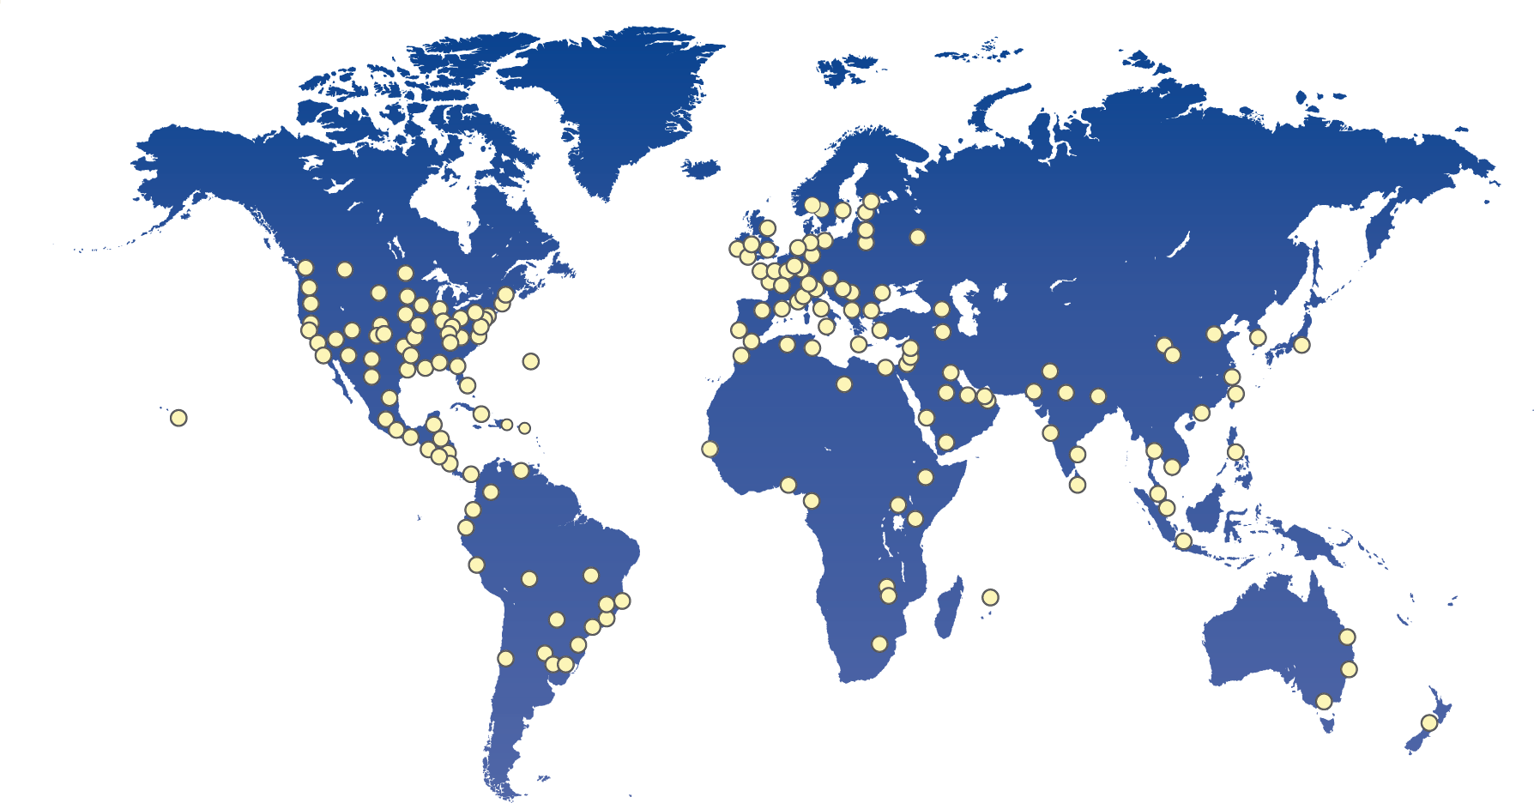
TAG Alliances Global Reach
290+ Members
750+ Offices
18,000+
Professionals
105+ Countries

Slide 4
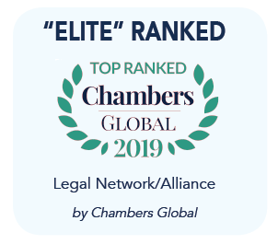
About TAGLaw
Founded in 1998, TAGLaw is
one of the largest legal
alliances in the world
160+ firms are located across
six continents and more than 90+ countries
Over 9,000 lawyers
Firms are carefully selected based on their professional competence, commitment to client service, and reputation within the legal community

Slide 5
Benefits of Using a TAGLaw Firm
In a word… ACCESS
To high-quality, trusted legal counsel worldwide
To expertise across a broad spectrum of industries and practice areas
To lawyers with local market knowledge in nearly every jurisdiction in the world
To right-sized firms

Slide 6
An Alliance of Quality Law Firms
All TAGLaw firms commit to the highest
standards of client service with respect to:
Quality of work
Service
Responsiveness
Communication
Ethics
Confidentiality
Conflicts
Billing

Slide 7
TAGLaw: Keeping Ahead
TAGLaw lawyers rank among the best in their field and jurisdiction
TAGLaw members meet two or more times a year to maintain strong relationships
TAGLaw Specialty Groups keep members in touch with their colleagues and on top of developments nationally and worldwide
Updated August 2018

